Slide 1

Study on survival rate of breast cancer patients
Submitted by,
21375018:DEVIKA DIVAKARAN
21375037:MUHAMMED ASHIQUE M.K

Slide 2
introduction

Slide 3
What is breast cancer treatments,stages

Slide 4
Objective
Aim of study is to evaluate the association between different treatments and other factors on survival time of breast cancer patients using cox regression.
METHOD USED

Slide 6
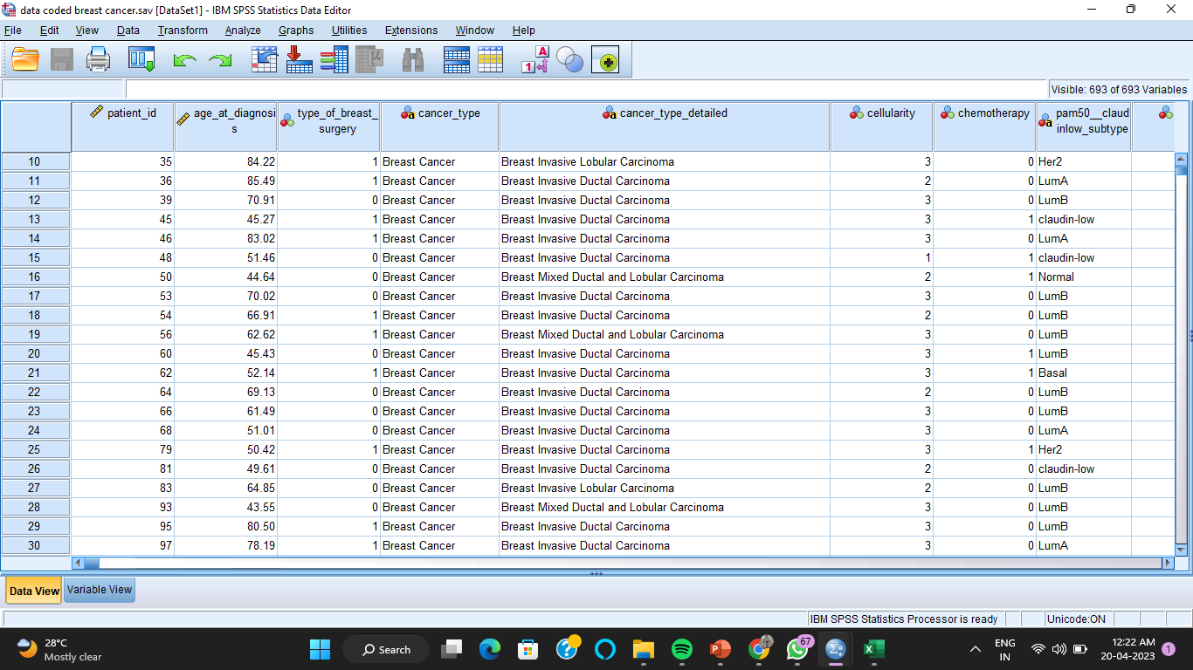
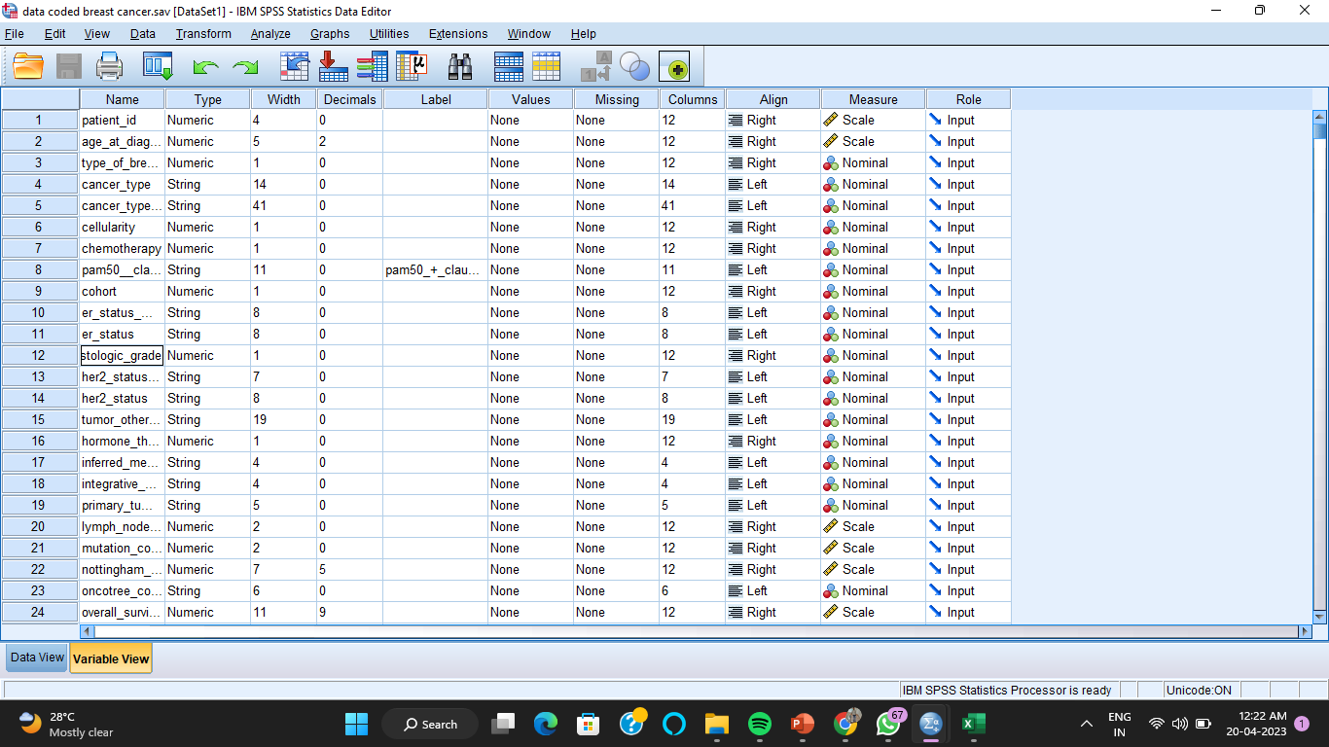
Data used

Slide 7
Variable under study
Dependent variable-Dying from breast cancer-Overall survival
Age: Age of the patient at diagnosis time(covariate)
Type of breast surgery:(categorical)-factors
1- MASTECTOMY, which refers to a surgery to remove all breast tissue from a breast as a way to treat or prevent breast cancer.
2- BREAST CONSERVING, which refers to a surgery where only the part of the breast that has cancer is removed
Cellularity:Cancer cellularity post chemotherapy, which refers to the amount of tumor cells in the specimen and their arrangement into clusters.
Hormone therapy:Whether or not the patient had hormonal as a treatment(1/0)
Overall survival months:Duration from the time of the intervention to death
overall survival:Target variable wether the patient is alive of dead
Radio therapy:Whether or not the patient had radio as a treatment (1/0)
Cohort:A collection of individual share certain characteristic or have been exposed to similar experiences.

Slide 8
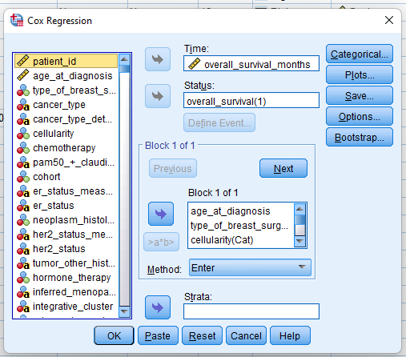
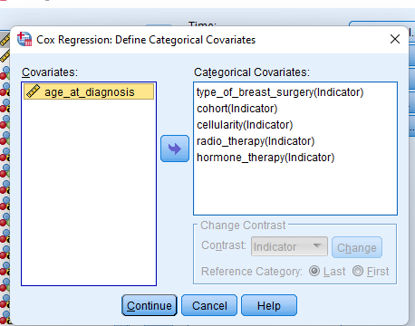
Method Used

Slide 9
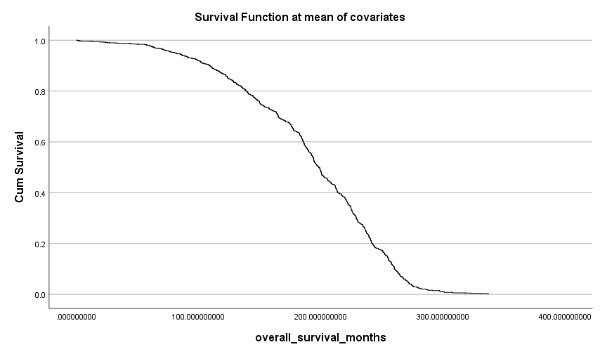
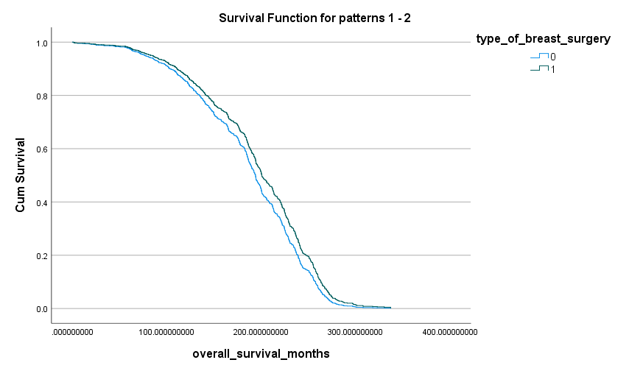
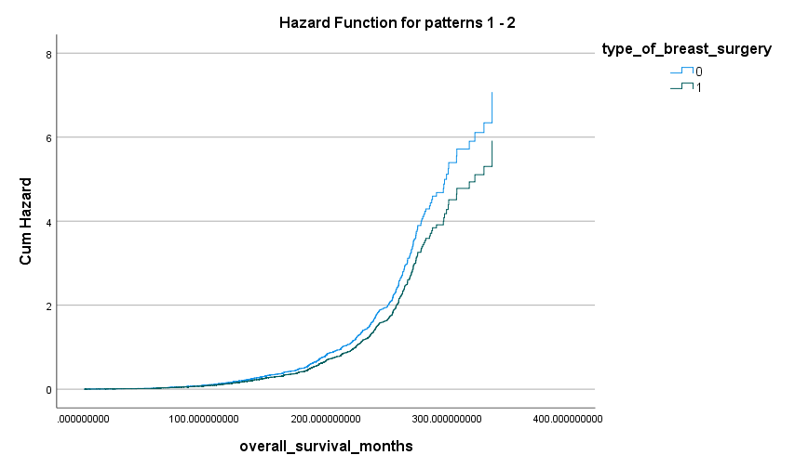
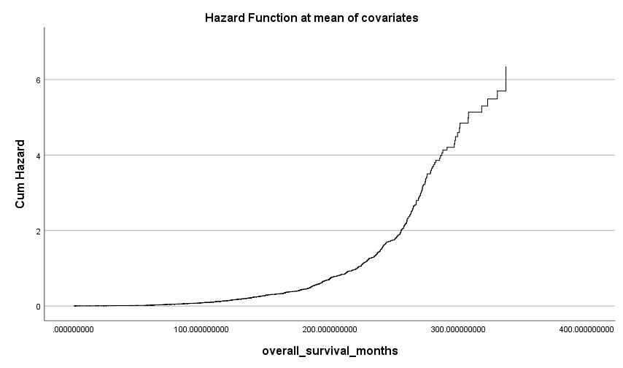

Slide 10
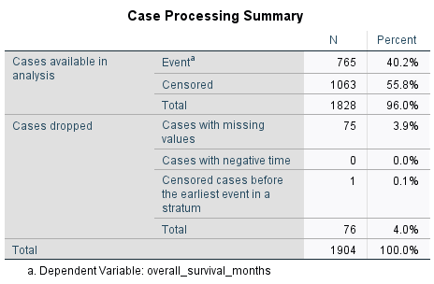
OUTPUT
Overall survival
1:patient died
0:patient alive(censored)

Slide 11
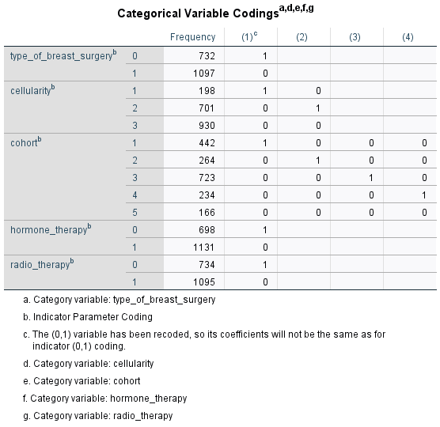
Which have 0 category it takes as reference category. Hazard rate will be interpret for which have category 1.
Cohort 5 is here taken as reference category. We will receive 4 hazard ratios. And will compare using cohort 5.
Type of breast surgery
0:Mastectomy
1:breast conserving-Reference category
Hormone therapy
0:Done
1:Not done

Slide 12
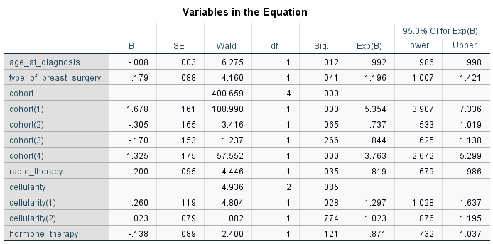
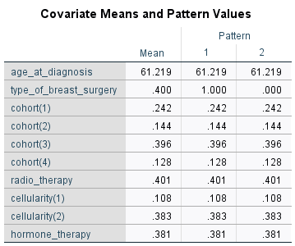
Exp(B) is the hazard ratio
B value
+ve:Increased hazard and decreased survival time
-ve:Decreased hazard and increased survival time
P value:
By increase of I year of age the chances of dying by breast cancer is 0.8%.
The hazard rate of patients who received mastectomy is 19% higher than that of patients who were undergo breast conserving based on this result breast conserving is better than mastectomy.
Hazard rate of the patients in cohort 1 is 5.35 times higher than that of patients in cohort 5.That is people in cohort 1 corresponds to people in cohort 5 has 5.35 times higher chance of dying as compared to cohort 5.

Slide 13
Result and Conclusion
Age is a significant covariate hazard rate of the patient decreases by 0.8 percentage when age increases by 1 year.
Hazard rate of the patients in cohort 1is 5.35 times higher than that of patients in cohort 5.
Hazard rate of patient in cohort 4 is 3.76 higher than that of cohort 5.
Hazard rate of patients in cohort 2,3,5 are almost same.
Hazard rate of patients who received radiotherapy is18.1% less than that of patients who doesn’t receive or undergo radiotherapy.
Cellularity is not a significant covariate.
Hazard rate of patients who were undergo hormone therapy is 13% less than that of patients who were not.
The hazard rate of patients who received mastectomy is 19% higher than that of patients who were undergo breast conserving based on this result breast conserving is better than mastectomy.

Slide 14
Reference
https://www.kaggle.com/datasets/raghadalharbi/breast-cancer-gene-expression-profiles-metabric
https://www.ncbi.nlm.nih.gov/pmc/articles/PMC3587870/
https://www.ncbi.nlm.nih.gov/pmc/articles/PMC2394262/

Slide 15
Thank You

